Slide 1
Project Title:
Knowledge Expansion via LLM-
Automated Graph Construction and
Adaptive Question Generation
Name of Intern: Afnan Shakil Sayyad College: Walchand College of Engineering, Sangli Mentor: Dr. Vaishali Sadaphal
Acknowledgments: Dr. Sangameshwar Patil, Rutuja Vaidya, Alok Kumar, Pratik Research Area: AIML
Saini, Shubham Kumbhar
1
TCS confidential
Notes:
Good morning all. I am Afnan Sayyad B.Tech Final Year student from Walchand College of Engineering, Sangli and through this internship, under the mentorship of Dr. Vaishali Sadaphal, I'm working on the project ‘Dynamic Knowledge Expansion via LLM-Automated Graph Construction and Adaptive Question Generation.’ This project focuses on using Large Language Models and ML methodologies to automatically build and expand knowledge graphs and generate adaptive questions for personalized learning and assessment.

Slide 2
Problem Statement:
Objective:
To reproduce and obtain the results of the paper Beyond Static Question Banks: Dynamic Knowledge Expansion via LLM-Automated Graph Construction and Adaptive Generation
Traditional assessments are static and not personalized to individual learners
Authors: Yingquan Wang, Li Zeng,
(Published on arxiv.org - Feb 2026 )
Tianyu Wei, Qinsi Li
To adapt the approach and build a system for DBMS course materials
Manual creation of personalized assessments is time-consuming and difficult to scale
Track learner mastery using Bayesian Knowledge Tracing (BKT)
Existing assessments often fail to adapt to learner responses and measure deeper understanding effectively
Dynamically adapt the next concept, difficulty, and question based on learner responses
2
TCS confidential
Notes:
So Let's first define the problem: we know that traditional assessments are static, difficult to personalize, and do not adapt to learner responses. It is not like every learner starts from the same starting point and learns at the same pace. So to address this, my objective is to reproduce and extend the research work done on dynamic knowledge expansion and adaptive question generation. This particular paper is very recent published in Feb 2026. In this project I adapt the approach for DBMS course content, use Bayesian Knowledge Tracing to track learner mastery, and dynamically adjust the next concept, question difficulty, and assessment flow based on learner performance.

Slide 3
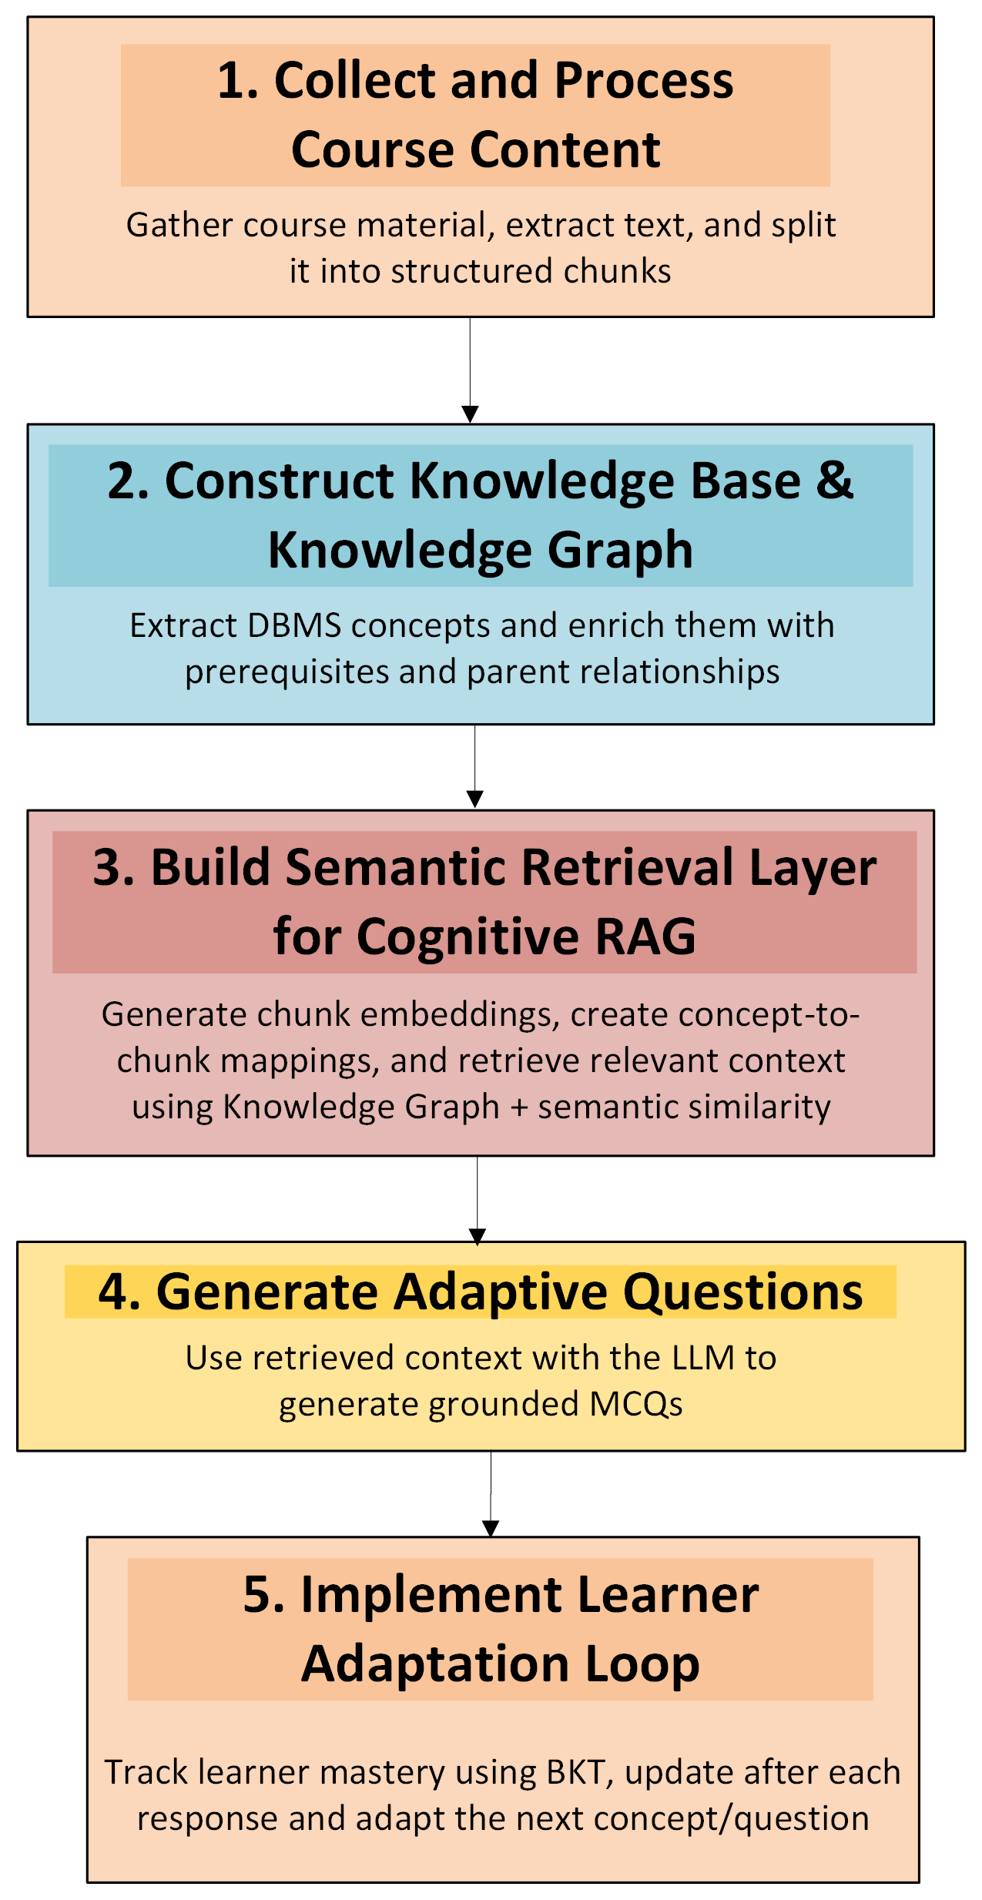
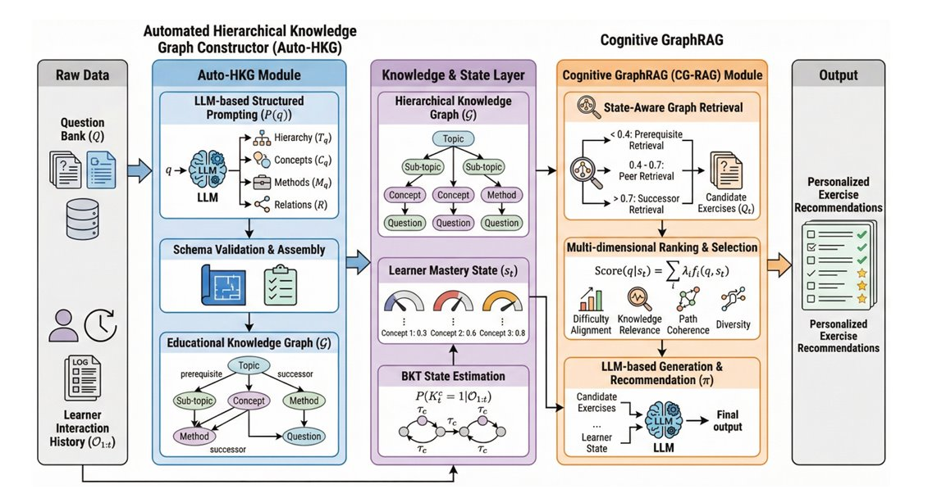
Implementation Steps
Our Implementation Steps
Authors’ Implementation Steps
Notes:
Now this slide shows how our implementation is derived from the authors’ framework. The original approach combines automated knowledge graph construction from the existing question bank, modeling the learner's state using Bayesian Knowledge Tracing, and adaptive recommendation through Cognitive GraphRAG.
In our implementation, we first collect and process DBMS course content by extracting and chunking the learning material. Next, we construct a knowledge graph that captures concepts and prerequisite relationships. We then build a semantic retrieval layer to retrieve relevant learning context using both the knowledge graph and vector similarity search. Based on the retrieved context, the LLM generates adaptive questions. Finally, learner performance is tracked using Bayesian Knowledge Tracing, which helps dynamically select the next concept and adjust the difficulty level of subsequent questions.

Slide 4
Challenges
1
Paper constraint: Educational KG construction should be automated and scalable.
Our adaptation: LLMs are used for concept extraction, cleanup, and prerequisite enrichment.
2
Evaluation constraint: No gold standard available
Our approach: Used metrics for graph quality, retrieval coverage, and learner progress.
3
Additional constraint: Lexical retrieval missed concepts.
Our solution: Added semantic embedding-based mapping and retrieval.
Notes:
Now I highlight the key challenges and how we addressed them. The original paper assumes the availability of a question bank for knowledge graph construction, whereas we build the knowledge graph directly from DBMS textbook content.
And to achieve scalability, we use LLMs for concept extraction, data cleanup, and prerequisite relationship enrichment.
Since there is no gold-standard benchmark available for evaluation, we rely on standard metrics to measure graph quality, retrieval effectiveness, and learner progress.
Finally, to overcome the limitations of keyword-based retrieval, we incorporate semantic embeddings, enabling more accurate concept mapping and context retrieval.

Slide 5
Tools/Technologies Used:
Implementation Framework
Methodologies:
Programming Language: Python
Embedding Model: text-embedding-3-small
LLM: Azure OpenAI (GPT-4o)
Knowledge Graph Visualization: NetworkX, PyVis
Adaptive Learning: Bayesian Knowledge Tracing (BKT)
User Interface: Streamlit
Hybrid RAG (Graph-Aware Retrieval)
Semantic Retrieval
LLM-Based Concept Extraction and Enrichment
Source-Grounded MCQ Generation
Concept mastery tracking using BKT and confidence on BKT
Notes:
Moving to the Implementation Framework: The solution is developed in Python, using OpenAI GPT-4o for concept extraction, knowledge enrichment, and adaptive question generation. For semantic understanding, I use OpenAI's text-embedding-3-small embedding model, while NetworkX and PyVis are used to construct and visualize the knowledge graph.
From a methodology perspective, the system combines Hybrid Graph-Aware RAG with semantic retrieval to fetch relevant learning context. Questions are generated using source-grounded content, and learner mastery is continuously tracked using Bayesian Knowledge Tracing, enabling personalized and adaptive assessments through a Streamlit-based user interface.

Slide 6
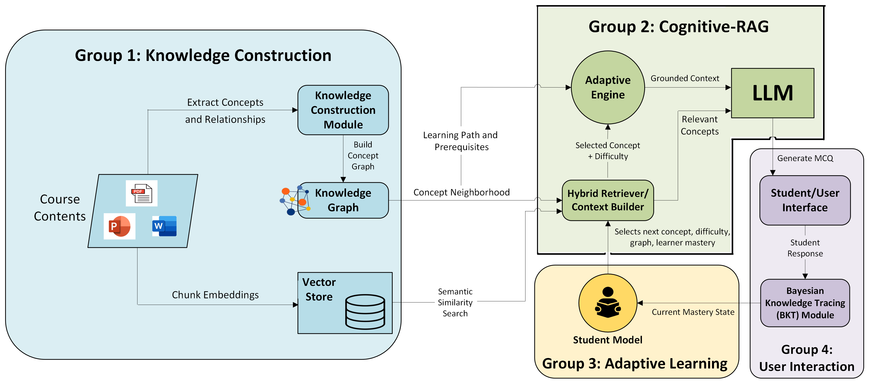
Proposed Solution Architecture
Notes:
Let's go through the overall architecture of the proposed solution. The system is divided into four major groups.
In Group 1, course content is processed to extract concepts and relationships. These are used to construct a Knowledge Graph, while the content chunks are converted into embeddings and stored in a Vector Store.
In Group 2, the Cognitive RAG module combines information from both the Knowledge Graph and the Vector Store through a hybrid retrieval mechanism. The adaptive engine uses this context, along with learner information, to select the most appropriate concept and difficulty level.
In Group 3, learner mastery is maintained through a student model based on Bayesian Knowledge Tracing, which continuously updates the learner’s knowledge state.
Finally, in Group 4, the LLM generates grounded MCQs, the learner responds through the user interface, and the BKT module updates the mastery level to personalize subsequent questions.

Slide 7
Experiment Setup
5
Adaptive Learning Setup:
Learner mastery was initialized using BKT with:
1
6
Domain Selected: Database Management Systems (DBMS)
P(Initial Knowledge) = 0.2
P(Guess) = 0.2
P(Slip) = 0.1
P(Learning Rate) = 0.1
System Output Evaluated:
Input Data Source: DBMS textbooks/course content
The system was evaluated based on
Knowledge Graph Construction Quality
Retrieval coverage improvement
Learner Specific Confidence Score based on:
Grounded question generation
No. of attempts
Consistency Variability
State Transition updates using BKT + Confidence
2
Dataset Size:
4084 text chunks from DBMS content
3
4
610 DBMS Concepts extracted and enriched
Knowledge Graph Schema:
Retrieval Methods Compared:
DBMS concepts were enriched with
Lexical+Graph based retrieval
632 Knowledge Graph Nodes created
Coarse-Grained relationships
Semantic Embedding based retrieval
Prerequisite relationships
2168 graph edges generated
Fine-grained dependency links
Notes:
Moving on to the experiment setup:
The selected domain for this implementation is Database Management Systems, and the input data consists of DBMS textbooks and course materials.
Our dataset contains 4,084 text chunks, from which 610 concepts were extracted and enriched, resulting in 632 knowledge graph nodes and 2,168 relationships. The knowledge graph captures parent-child, prerequisite, and concept dependency relationships.
To evaluate retrieval performance, I compare traditional lexical graph-based retrieval with semantic embedding-based retrieval. Learner adaptation is handled using Bayesian Knowledge Tracing with it's paramters initialized as , which updates mastery after every response. Finally, the system is evaluated based on knowledge graph quality, retrieval coverage, grounded question generation, and the effectiveness of BKT state transitions.

Slide 8
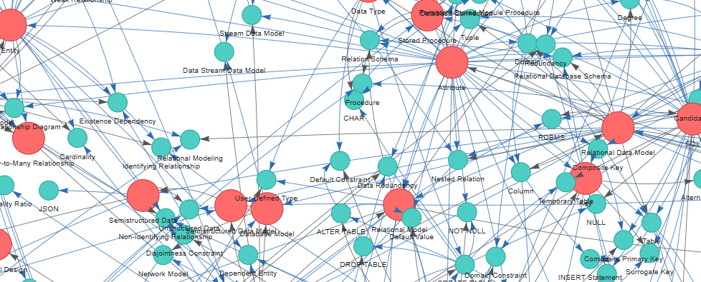
Results
Comparison
Total Chunks: 4084
Metric | Lexical Mapping | Semantic Embedding
Concepts with Chunks | 540 | 610
Zero-Match Concepts | 70 | 0
Unique Chunks Used | 2893 | 2241
Average Chunks per Concept | 24.69 | 25
Median Chunks per Concept | 5 | 25
Max Chunks for one Concept | 945 | 25
Average Chunk Reuse | 5.22 | 6.84
Chunks reused by >20 Concepts | 14 | 177
No. Of Chunks | 1000 | 2042 | 4084
Concepts | 1039 | 1479 | 2260
Unique Concepts | 610 | 765 | 1098
+25.41%
+43.53%
Overall, from 1000 to 4084 chunks, Concepts grew by 117.5% and Unique Concepts grew by 80.0%
Knowledge Graph (For 1k Chunks)
Total Nodes: 632 | Total Edges: 2168
Average Jaccard overlap = 0.0856
Semantic mapping retrieved different chunks than lexical mapping
Notes:
Finally the results achieved till now by this project: The key takeaway from comparing retrieval approaches is that semantic embedding-based retrieval significantly outperforms traditional lexical retrieval in terms of concept coverage and knowledge discovery
as it successfully covers all 610 concepts, while lexical mapping left 70 concepts unmatched.
We also observe that as more educational content is added, the system continues to discover new concepts and relationships, leading to substantial growth in the knowledge graph. Overall, these results validate that the proposed approach can effectively expand domain knowledge, improve retrieval quality, and provide a strong foundation for adaptive question generation and personalized learning.

Slide 9
Learner Simulation Results: Weak vs Strong Learner
With BKT
With BKT + Confidence on BKT
9
TCS confidential
Notes:
Good morning all. I am Afnan Sayyad B.Tech Final Year student from Walchand College of Engineering, Sangli and through this internship, under the mentorship of Dr. Vaishali Sadaphal, I'm working on the project ‘Dynamic Knowledge Expansion via LLM-Automated Graph Construction and Adaptive Question Generation.’ This project focuses on using Large Language Models and ML methodologies to automatically build and expand knowledge graphs and generate adaptive questions for personalized learning and assessment.

Slide 10
With BKT:-
Case 1: Weak Learner
Step | Learner Response | Updated P(Learning Rate) | Difficulty State | Current Concept
Start | — | 0.200 | Easy | 3NF
Q1 | Wrong | 0.127 | Easy | 3NF
Q2 | Wrong | 0.116 | Easy | Functional Dependency
Q3 | Wrong | 0.115 | Easy | Attribute
Q4 | Correct | 0.431 | Medium | Attribute
Q5 | Wrong | 0.178 | Easy | Attribute
Simulated with low correct-answer probability
The learner starts with 3NF
Interpretation
After wrong responses, the system moves backward to prerequisite concepts
Difficulty mostly remains Easy because mastery stays low
Case 2: Strong Learner
Step | Learner Response | Updated P(Learning Rate) | Difficulty State | Current Concept
Start | — | 0.200 | Easy | 3NF
Q1 | Correct | 0.576 | Medium | 3NF
Q2 | Correct | 0.874 | Hard | BCNF
Q3 | Correct | 0.972 | Hard | BCNF
Q4 | Correct | 0.994 | Hard | 4NF
Q5 | Correct | 0.998 | Hard | 4NF
Simulated with high correct-answer probability
The learner starts with 3NF
Interpretation
Correct answers quickly increase P(L)
Once mastery crosses 0.8, system moves to successor concepts
The learner progresses from 3NF → BCNF → 4NF
Notes:
This slide demonstrates how the adaptive learning system behaves for different learner profiles. In both cases, the learner starts with the concept 3NF and an initial mastery probability of 0.2.
For the weak learner, repeated incorrect answers decrease the mastery estimate, so the system keeps the difficulty at the easy level and moves back to prerequisite concepts such as Functional Dependency and Attribute to strengthen foundational knowledge.
For the strong learner, correct answers rapidly increase the mastery probability. Once the mastery crosses the threshold of 0.8, the system advances to successor concepts and increases the difficulty level. As a result, the learner progresses from 3NF to BCNF and then to 4NF, demonstrating personalized concept sequencing and difficulty adaptation using Bayesian Knowledge Tracing.

Slide 11
Interpretation:
The simulation shows that BKT updates mastery very quickly, especially after correct answers
Because of this fast transition, the system moves from Easy to Hard difficulty very early. This may not always reflect true learner readiness
The current p_know value should be treated as a probabilistic estimate, not a guaranteed reflection of actual learner understanding.
Therefore BKT should not only output p_know, but also a confidence level to show how reliable the mastery estimate is, especially when decisions are based on only a few responses.
12
TCS confidential
Notes:
So Let's first define the problem: we know that traditional assessments are static, difficult to personalize, and do not adapt to learner responses. It is not like every learner starts from the same starting point and learns at the same pace. So to address this, my objective is to reproduce and extend the research work done on dynamic knowledge expansion and adaptive question generation. This particular paper is very recent published in Feb 2026. In this project I adapt the approach for DBMS course content, use Bayesian Knowledge Tracing to track learner mastery, and dynamically adjust the next concept, question difficulty, and assessment flow based on learner performance.

Slide 12
With BKT + Confidence:-
Step | Learner Response | Updated P(Learning Rate of Concept) | Confidence Score | Difficulty State | Current Concept(s): Weight
Start | — | 0.200 | 0 | — | 4NF
Q1 | Wrong | P(4NF): 0.127 | C(4NF):0.08 | Easy | 4NF: 1.0
Q2 | Wrong | P(4NF): 0.119 P(MD): 0.178 | C(4NF): 0.18 C(MD): 0.08 | Easy | 4NF: 0.7 Multivalued Dependency: 0.3
Q3 | Correct | P(4NF): 0.441 | C(4NF): 0.14 | Easy | 4NF: 1.0
Q4 | Wrong | P(4NF): 0.272 P(BCNF): 0.141 | C(4NF): 0.25 C(BCNF): 0.08 | Medium | 4NF: 0.65 BCNF: 0.35
Q5 | Wrong | P(BCNF): 0.141 P(FD): 0.175 | C(BCNF): 0.18 C(FD): 0.08 | Easy | BCNF: 0.65 Functional Dependency: 0.35
Q6 | Wrong | P(BCNF): 0.126 P(FD): 0.157 | C(BCNF): 0.30 C(FD): 0.18 | Easy | BCNF: 0.65 Functional Dependency: 0.35
Q7 | Wrong | P(BCNF): 0.115 | C(BCNF): 0.43 | Easy | BCNF: 1.0
Q8 | Wrong | P(BCNF): 0.114 | C(BCNF): 0.57 | Easy | BCNF: 1.0
Q9 | Correct | P(BCNF): 0.431 | C(BCNF): 0.49 | Easy | BCNF: 1.0
Q10 | Correct | P(BCNF): 0.668 P(FD): 0.280 | C(BCNF): 0.48 C(FD): 0.14 | Medium | BCNF: 0.65 Functional Dependency: 0.35
Q11 | Correct | P(BCNF): 0.826 P(3NF): 0.332 | C(BCNF): 0.50 C(3NF): 0.08 | Medium | BCNF: 0.65 3NF: 0.35
Case 1: Weak Learner
Moved to prerequisite
BCNF
Mastered ✅
Moved to next unmastered prerequisite of original concept (4NF)
Notes:
This slide demonstrates how the adaptive learning system behaves for different learner profiles. In both cases, the learner starts with the concept 3NF and an initial mastery probability of 0.2.
For the weak learner, repeated incorrect answers decrease the mastery estimate, so the system keeps the difficulty at the easy level and moves back to prerequisite concepts such as Functional Dependency and Attribute to strengthen foundational knowledge.
For the strong learner, correct answers rapidly increase the mastery probability. Once the mastery crosses the threshold of 0.8, the system advances to successor concepts and increases the difficulty level. As a result, the learner progresses from 3NF to BCNF and then to 4NF, demonstrating personalized concept sequencing and difficulty adaptation using Bayesian Knowledge Tracing.

Slide 13
Interpretation:
The learner struggles with 4NF, so the system does not trust the current mastery value alone.
Using the confidence score, the system checks whether the direct prerequisites of 4NF are actually mastered.
If a prerequisite is weak, the system moves backward to that prerequisite, such as BCNF, Functional Dependency, or Multivalued Dependency.
After one prerequisite is mastered, the system moves to the next weakest direct prerequisite of 4NF.
Only after all direct prerequisites are mastered does the system return to 4NF.
13
TCS confidential
Notes:
So Let's first define the problem: we know that traditional assessments are static, difficult to personalize, and do not adapt to learner responses. It is not like every learner starts from the same starting point and learns at the same pace. So to address this, my objective is to reproduce and extend the research work done on dynamic knowledge expansion and adaptive question generation. This particular paper is very recent published in Feb 2026. In this project I adapt the approach for DBMS course content, use Bayesian Knowledge Tracing to track learner mastery, and dynamically adjust the next concept, question difficulty, and assessment flow based on learner performance.

Slide 14
Step | Learner Response | Updated P(Learning Rate of Concept) | Confidence Score | Difficulty State | Current Concept(s): Weight
Start | — | 0.200 | 0 | — | 4NF
Q1 | Correct | P(4NF): 0.46 P(MD): 0.31 | C(4NF):0.08 C(MD): 0.08 | Easy | 4NF: 0.7 Multivalued Dependency: 0.3
Q2 | Correct | P(4NF): 0.69 P(MD): 0.45 | C(4NF): 0.18 C(MD): 0.18 | Medium | 4NF: 0.65 Multivalued Dependency: 0.35
Q3 | Correct | P(4NF): 0.83 P(MD): 0.57 | C(4NF): 0.30 C(MD): 0.30 | Medium | 4NF: 0.65 Multivalued Dependency: 0.35
Q4 | Correct | P(3NF): 0.57 | C(3NF): 0.08 | Easy | 3NF: 1.0
Q5 | Correct | P(3NF): 0.76 P(FD): 0.33 | C(3NF): 0.18 C(MD): 0.08 | Medium | 3NF: 0.65 Functional Dependency: 0.35
Q6 | Correct | P(3NF): 0.88 P(FD): 0.46 | C(3NF): 0.30 C(FD): 0.18 | Medium | 3NF: 0.65 Functional Dependency: 0.35
Q7 | Correct | P(BCNF): 0.44 P(FD): 0.59 | C(BCNF): 0.08 C(FD): 0.30 | Easy | BCNF: 0.65 Functional Dependency: 0.35
Q8 | Correct | P(BCNF): 0.67 P(FD): 0.69 | C(BCNF): 0.18 C(FD): 0.43 | Medium | BCNF: 0.65 Functional Dependency: 0.35
Q9 | Correct | P(BCNF): 0.91 | C(BCNF): 0.30 | Medium | BCNF: 1.0
Q10 | Correct | P(MD): 0.76 P(FD): 0.77 | C(MD): 0.43 C(FD): 0.57 | Medium | Multivalued Dependency: 0.65 Functional Dependency: 0.35
Q11 | Correct | P(MD): 0.94 | C(MD): 0.57 | Medium | Multivalued Dependency: 1.0
Q12 | Correct | P(4NF): 0.96 | C(4NF): 0.43 | Hard | 4NF: 1.0
With BKT + Confidence:-
Case 2: Strong Learner
4NF
Mastered ✅
Moved to next unmastered successor of original concept (4NF)
Notes:
This slide demonstrates how the adaptive learning system behaves for different learner profiles. In both cases, the learner starts with the concept 3NF and an initial mastery probability of 0.2.
For the weak learner, repeated incorrect answers decrease the mastery estimate, so the system keeps the difficulty at the easy level and moves back to prerequisite concepts such as Functional Dependency and Attribute to strengthen foundational knowledge.
For the strong learner, correct answers rapidly increase the mastery probability. Once the mastery crosses the threshold of 0.8, the system advances to successor concepts and increases the difficulty level. As a result, the learner progresses from 3NF to BCNF and then to 4NF, demonstrating personalized concept sequencing and difficulty adaptation using Bayesian Knowledge Tracing.

Slide 15
Interpretation:
The learner answers correctly, so the mastery value for 4NF increases quickly.
Even if 4NF has high mastery and confidence, the system checks whether its prerequisites are also mastered.
If any direct prerequisite is still weak, the system moves to that prerequisite before progressing further.
Once all prerequisites and 4NF are mastered, the system allows progression to the next successor concept.
This prevents premature advancement and ensures the learner’s foundation is complete before moving ahead.
15
TCS confidential
Notes:
So Let's first define the problem: we know that traditional assessments are static, difficult to personalize, and do not adapt to learner responses. It is not like every learner starts from the same starting point and learns at the same pace. So to address this, my objective is to reproduce and extend the research work done on dynamic knowledge expansion and adaptive question generation. This particular paper is very recent published in Feb 2026. In this project I adapt the approach for DBMS course content, use Bayesian Knowledge Tracing to track learner mastery, and dynamically adjust the next concept, question difficulty, and assessment flow based on learner performance.

Slide 16
Future Scope
Create a gold-standard benchmark and compare system outputs against it
Improve Knowledge Graph quality through edge validation, and cleanup of noisy relationships
Conduct real learner testing using pre-test/post-test evaluation to measure actual learning gain
Extend the same architecture to generalize to other subjects beyond DBMS and to generate varied types of questions (descriptive, etc.)
16
TCS confidential
Notes:
Looking ahead as the future scope, the system can be further improved by creating a gold-standard benchmark for more objective evaluation. The quality of the knowledge graph can be enhanced through better validation and noise removal techniques. In addition, testing with real learners using pre- and post-assessments would help measure actual learning gains. and finally, this architecture can be extended beyond DBMS to other academic domains and subjects.

Slide 17
Key Learnings
Skills Gained
Learned how to build an end-to-end AI-powered adaptive assessment system from educational content.
Knowledge Graph construction using NetworkX
Understood how Knowledge Graphs can represent concepts, prerequisites, and learning paths
RAG system design combining graph context and semantic retrieval
Understood the role of Bayesian Knowledge Tracing (BKT) in tracking learner mastery
Adaptive learning implementation using BKT formulas and learner state tracking
Understood and applied different retrieval techniques:
Importance of good prompting techniques
Lexical retrieval
Graph-Aware retrieval
Semantic retrieval
Hybrid retrieval
17
TCS confidential
Notes:
Now the learnings I got, this internship helped me understand how to build an end-to-end AI-powered adaptive assessment system from grounded educational content. I gained information on knowledge graph construction, graph-aware and semantic retrieval techniques (Hybrid RAG), and BKT for learner modeling. I also noted importance of a good prompt, adaptive learning system design, and integrating LLMs into practical educational applications.
Overall, this project provided valuable experience in applying AI, knowledge graphs, and adaptive learning techniques to create personalized educational systems.

Slide 18
References/Literature Review
Beyond Static Question Banks: Dynamic Knowledge Expansion via LLM-Automated Graph Construction and Adaptive Generation (On arxiv.org) - Feb 2026
Books used:
1. Fundamentals of Database Systems PDF - Shamkant B. Navathe
Authors:- Yingquan Wang, Li Zeng, Tianyu Wei, Qinsi Li
(Georgia State University)
A Systematic Review on Assessment in Adaptive Learning: Theories, Algorithms and Techniques (On thesai.org) - Nov 2024
2.
(Stanford University)
2. Database Systems - Hector Garcia-Molina, Jeffrey D. Ullman, Jennifer Widom
Authors:- Adel Ihichr, Omar Oustous, Younes El Bouzekri El Idrissi, Ayoub Ait Lahcen
3. Database Design - Adrienne Watt, Nelson Eng
(Douglas College)
3.
Deep Computerized Adaptive Testing (On thesai.org) - Mar 2026
Authors:- Jiguang Li, Robert Gibbons, Veronika Rockova
18
TCS confidential
Notes:
At last these are the references I referred to while performing literature review and developing this solution. And these are the books I use as the source content

Slide 19
Thank You
Notes:
Thank You

